Slide 1
MovieProphecy
Team 6
Yogesh Bodhe
Abhishek Chakraborty
Zachary Chapman
Aravinda Kumar Reddy Yempada

Slide 2
Introduction
What is MovieProphecy?
Inspiration
Relevance
Big Data
Machine Learning

Slide 3
Sub Modules
Crawler
Classifier
Storage
UI

Slide 4
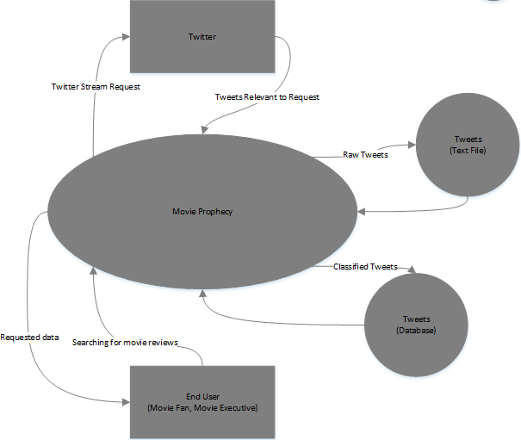
Context Diagram

Slide 5
Back End
Java
Twitter4J
LingPipe
Storage (Text and SQL Database)

Slide 6
Front End
ASP.NET
IIS
Integration with Back End

Slide 7
Demonstration
Use Case:
User - Movie Fan
User - Movie Executive

Slide 8
Sprints
Scrum
Sprint 1 - Crawler and classifier
Sprint 2 - Basic UI and search
Sprint 3 - Refined UI and Executive features

Slide 9
Challenges
Implementing LingPipe Classifier
Twitter & Rotten Tomatoes APIs
Hosting Considerations
Irrelevant Data from Twitter

Slide 10
Future Implementation
Mobility
Classifier Efficiency
Commercialization

